Slide 1
With This In Mind…

Slide 2
“If you could be friends with any celebrity that's trendy enough to be on Twitter, who would it be?”

Slide 3
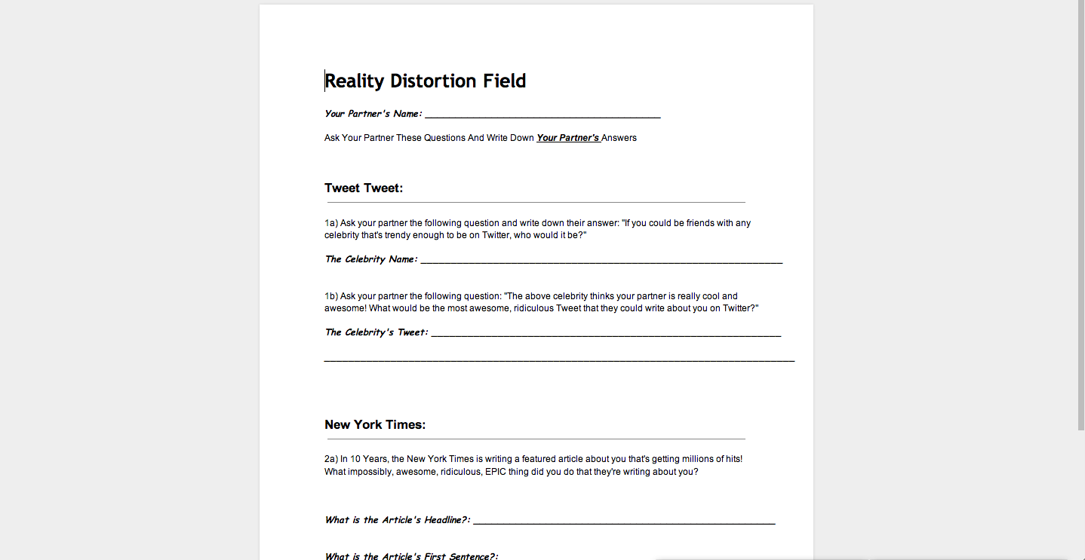
Open

Slide 4
“The above celebrity thinks you are really cool and awesome! What would be the most awesome, ridiculous tweet that they could write about you on Twitter?”

Slide 5
Open
Notes:
Print These Handouts Out

Slide 6
2 minutes
Person One ask person Two
the first question

Slide 7
Switch!

Slide 8
2 minutes
Person Two ask person One
the first question

Slide 9
In 10 Years, the New York Times is writing a featured article about you that's getting millions of hits! What impossibly, awesome, ridiculous, EPIC thing did you do that they're writing about you?

Slide 10
2 minutes
Person One ask person Two
the first question

Slide 11
Switch!

Slide 12
2 minutes
Person Two ask person One
the first question

Slide 13
You should now have a complete worksheet!

Slide 14
Let’s Look At My Partner’s Answers Again…
Notes:
Need to explain this to Kwame
And do quick run through with him

Slide 15
Open
Notes:
Print These Handouts Out

Slide 16
Reality Distortion Field

Slide 17
Note To Self
Side By Side Directions
Mousepose
Shift + Cmd + K
Shift + Cmd + M

Slide 18

Twitter.com/search
Using Google Chrome Open:

Slide 19
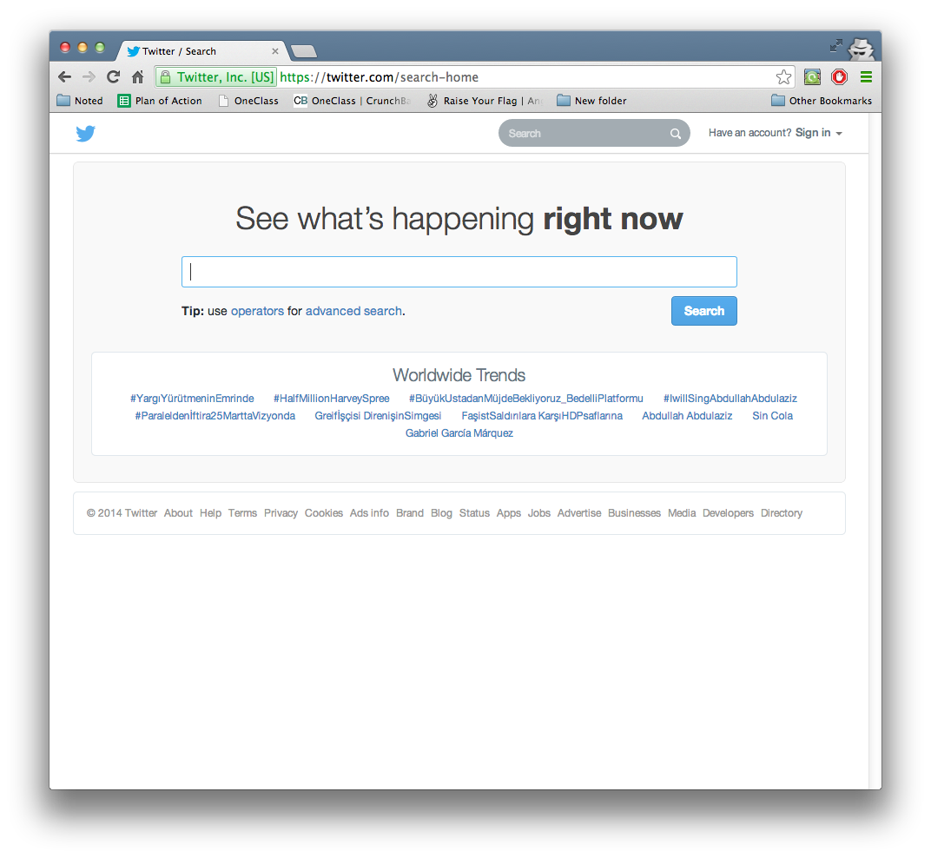
Twitter.com/search
Open

Slide 20

Search For Your Celeb
Open

Slide 21
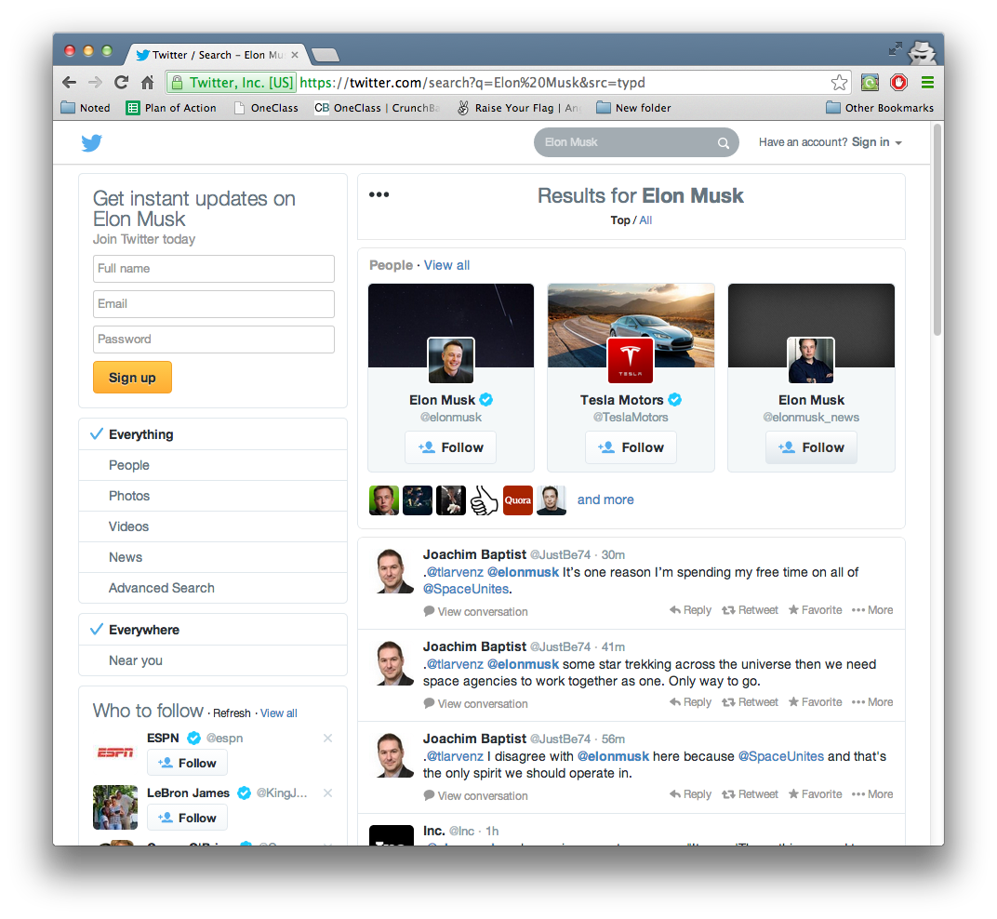
Open Their Profile

Slide 22
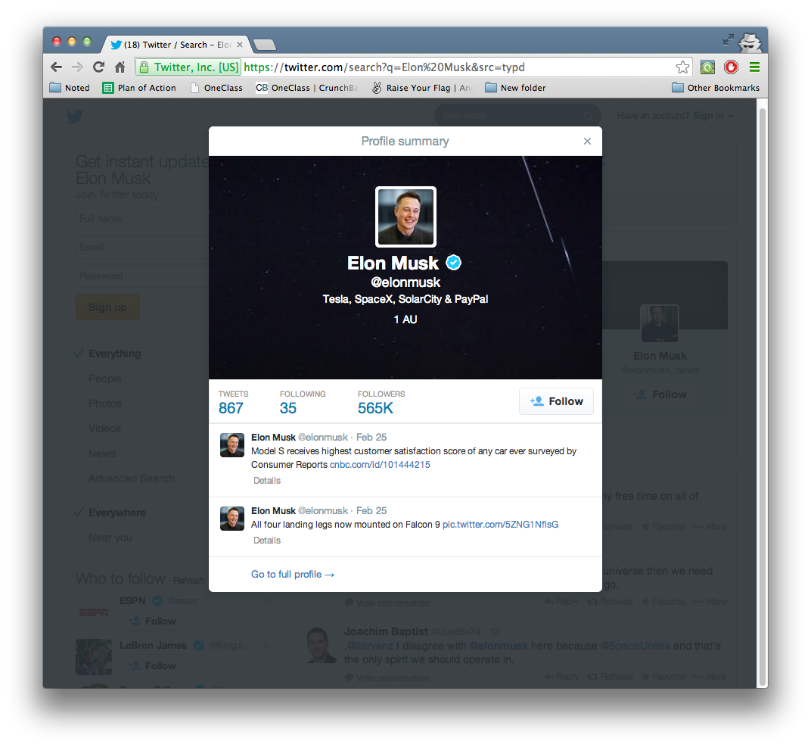
Click “Go to full profile”

Slide 23
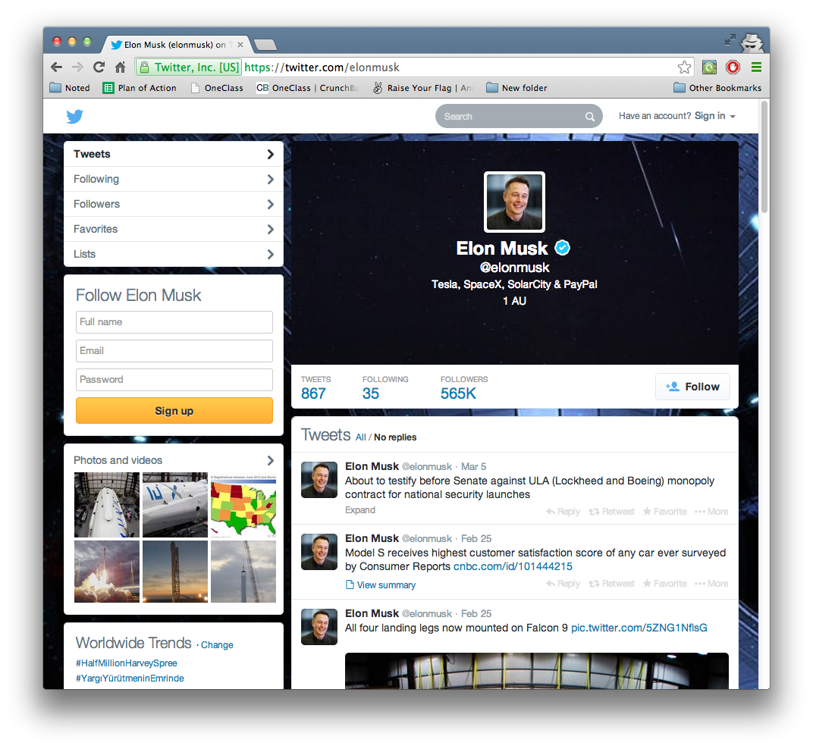
Find Their First Tweet

Slide 24
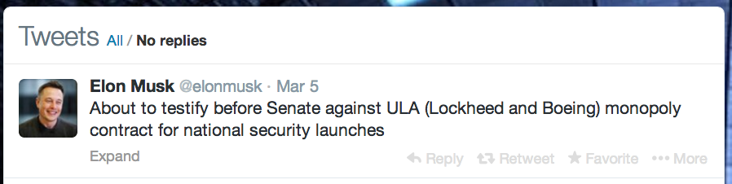
Right Click Any Word
In The Tweet

Slide 25

NO WHERE ELSE

Slide 26
NO WHERE ELSE

Slide 27
Right Click Any Word
In The Tweet

Slide 28
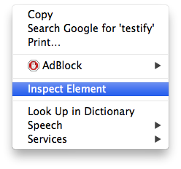
Then Click Inspect Element

Slide 29
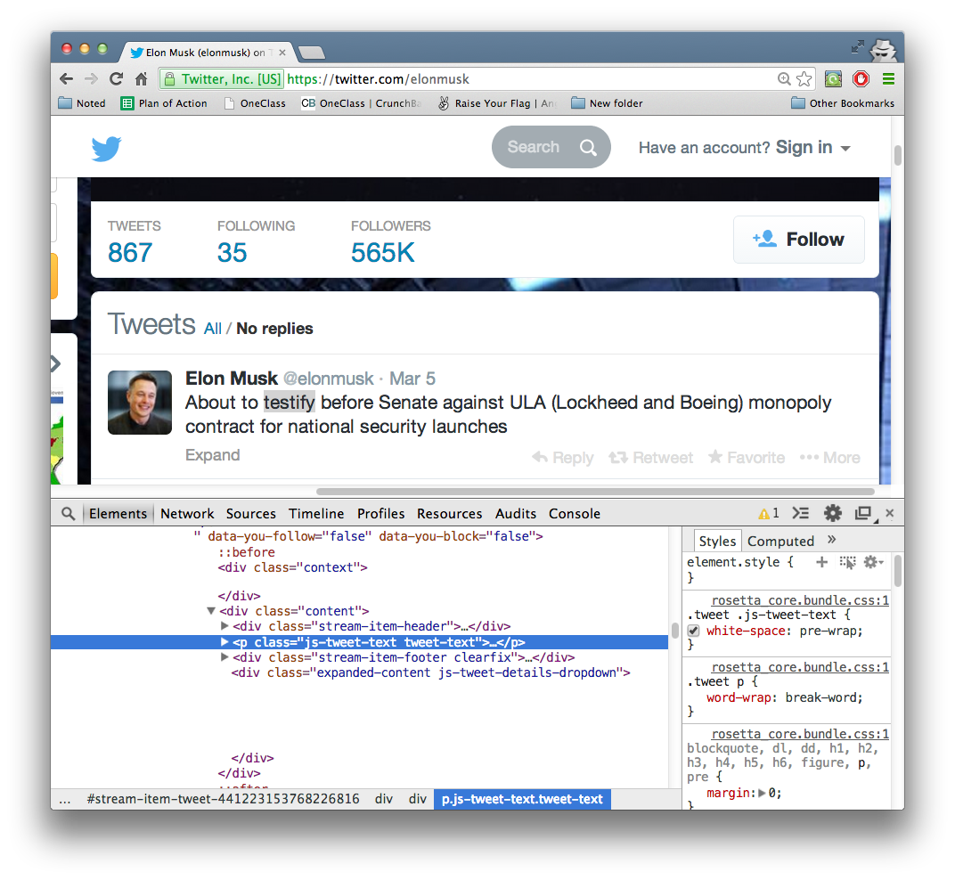
The Curtain Has Been Lifted!

Slide 30
Click on the gray arrow to expand
the text inside
Highlighted Blue Line

Slide 31
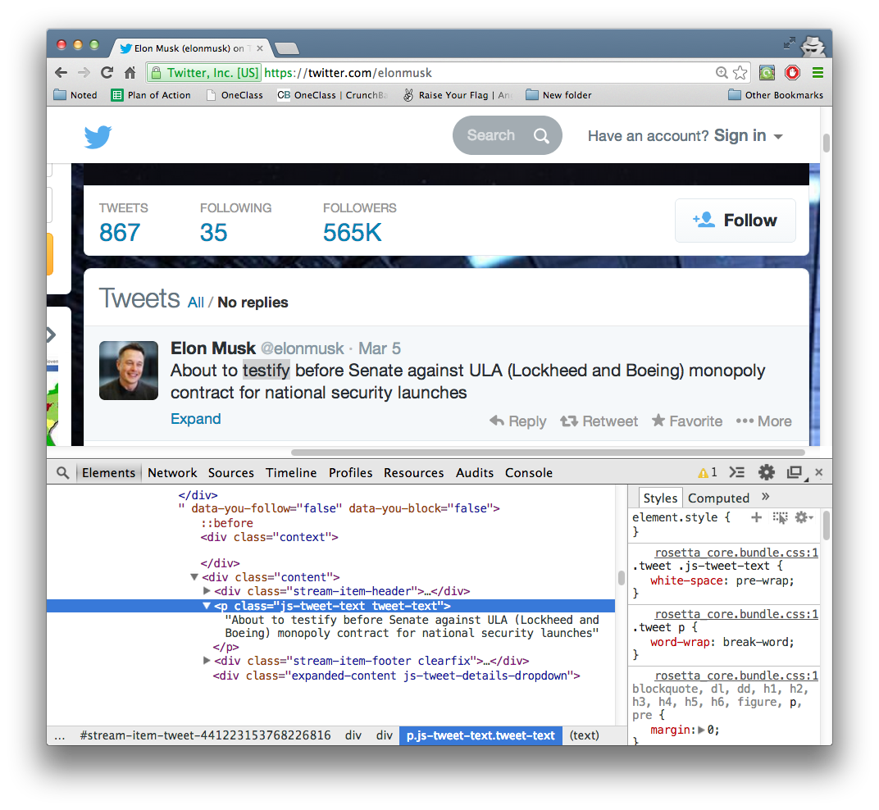
Double Click On The Text
To Modify It

Slide 32
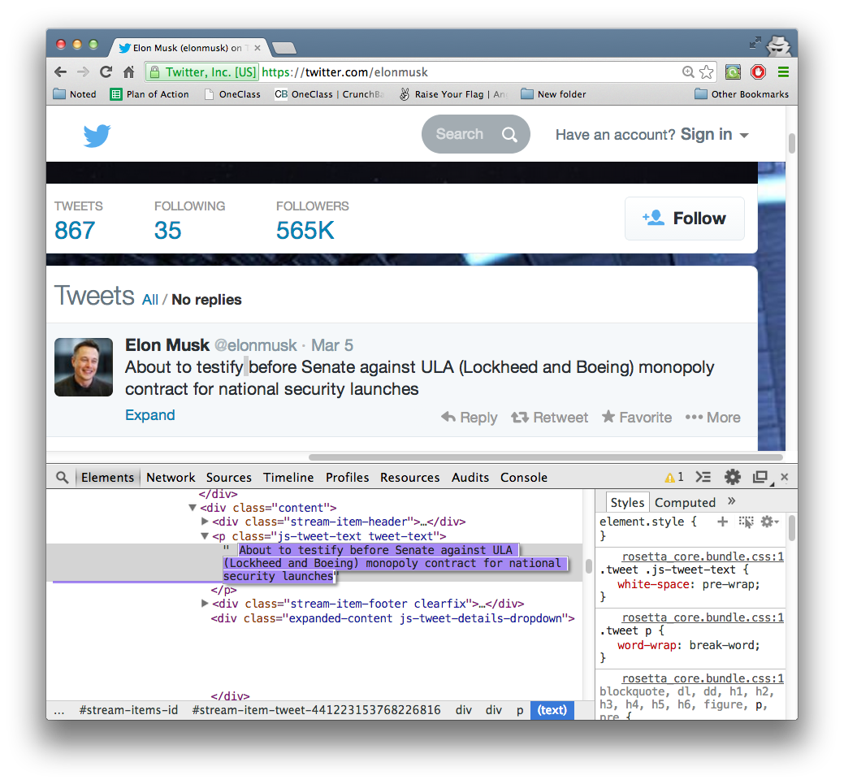
The Text Is Now Editable!
Type Away!

Slide 33
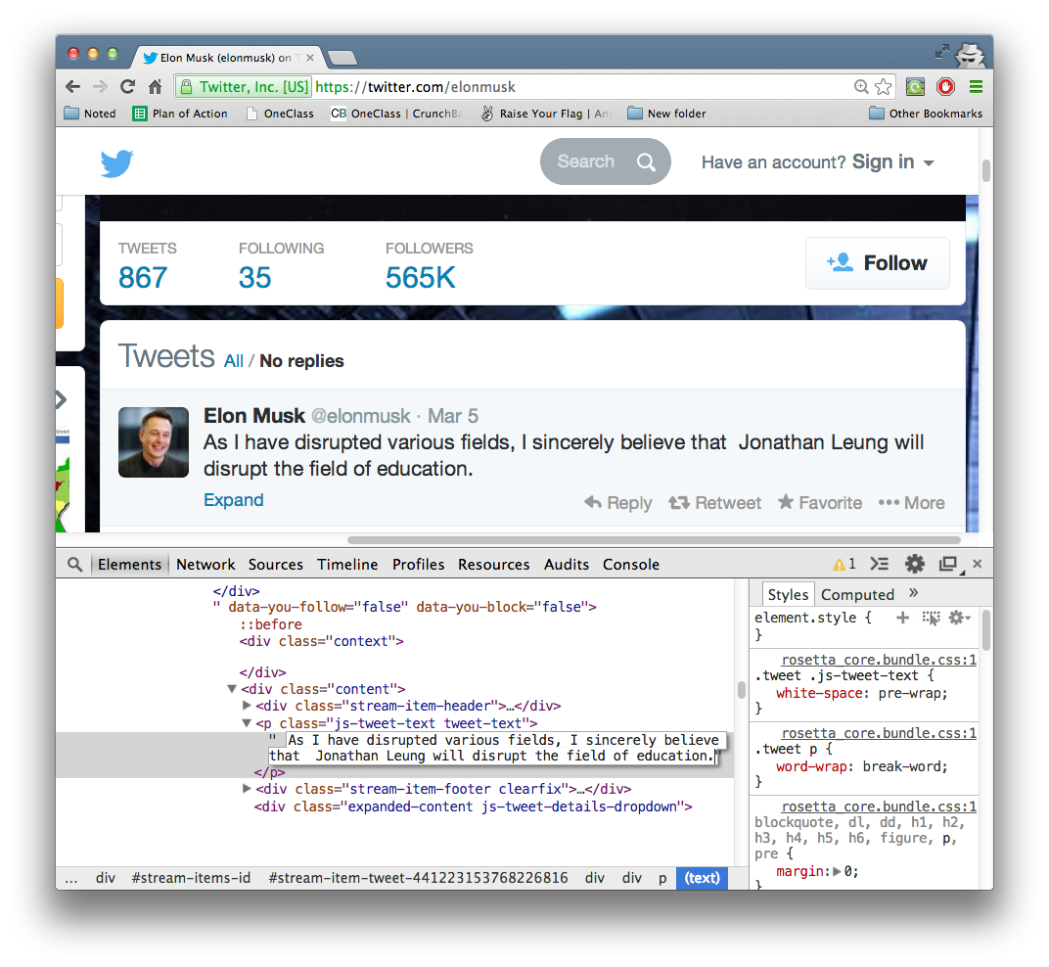
Modify The Text
When You’re Done Press Enter

Slide 34
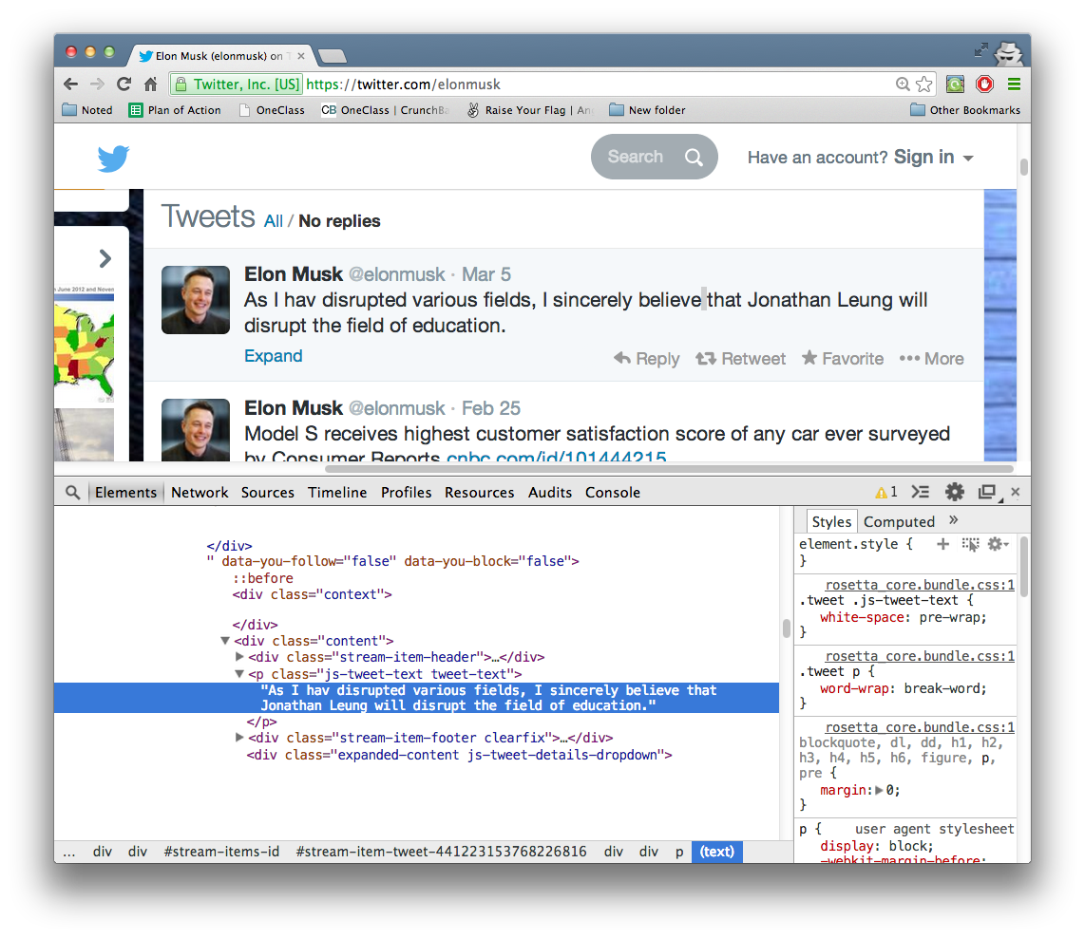
And Your Text Is Now Modified!

Slide 35
Ctrl + s (Windows) Cmd + s (Mac)
Now That You’re Done Editing
Save The Page By Pressing:

Slide 36
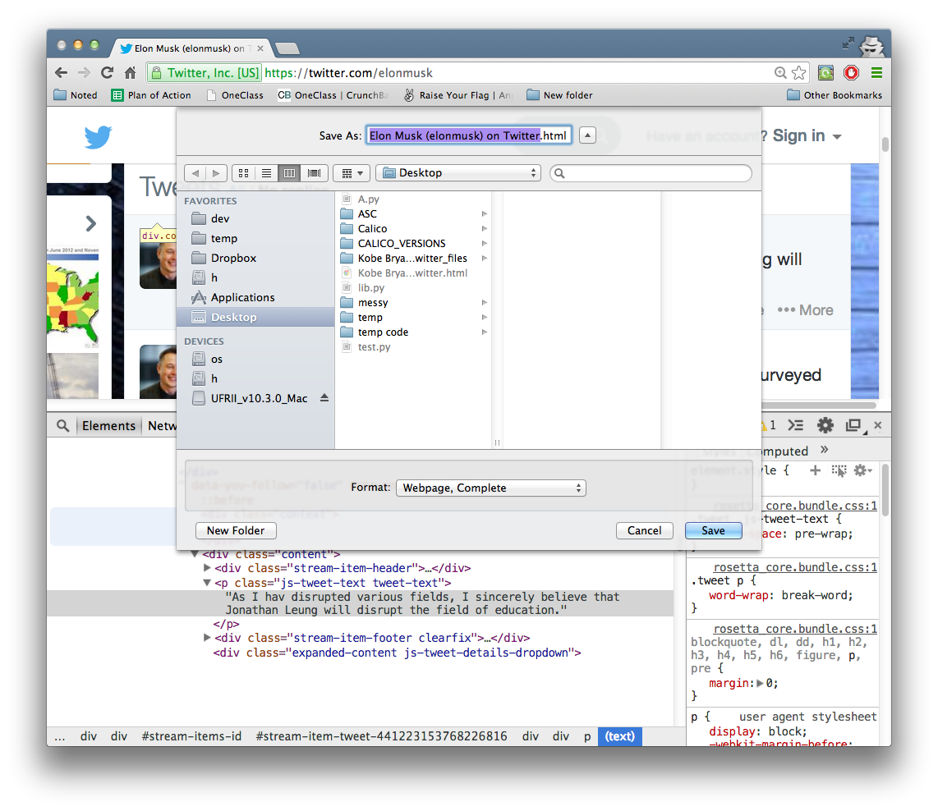
Go Ahead And Save It To Your Desktop

Slide 37
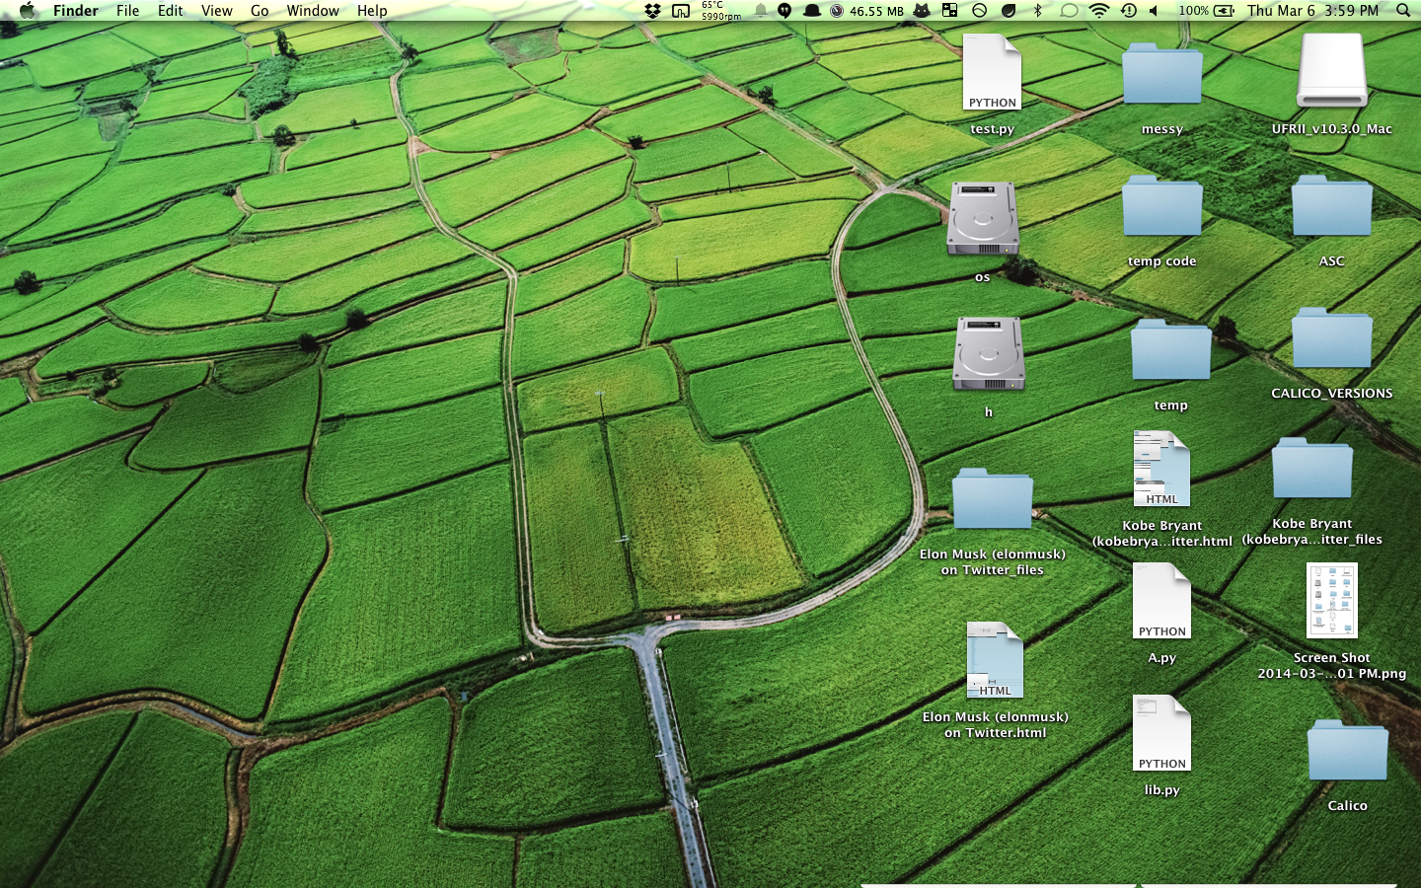
And 2 New Files Should Appear On Your Desktop

Slide 38
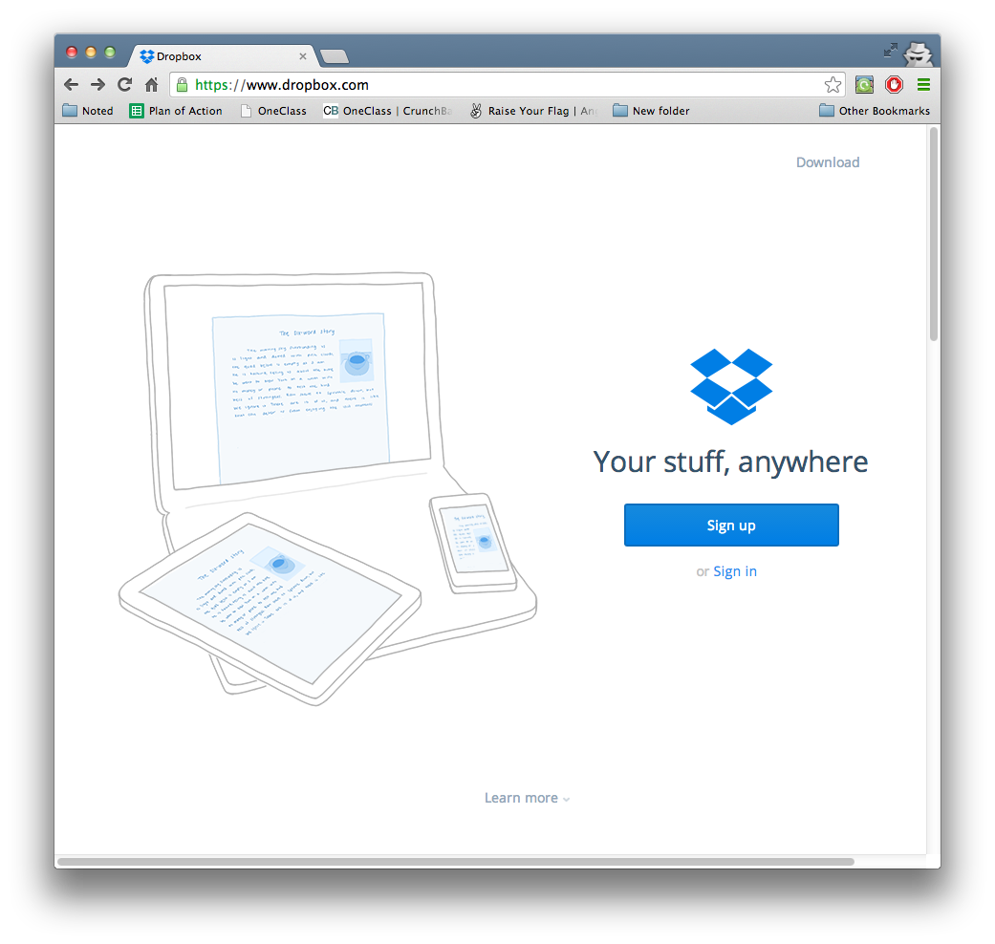
Open Dropbox.com

Slide 39
Click “Sign in”

Slide 40
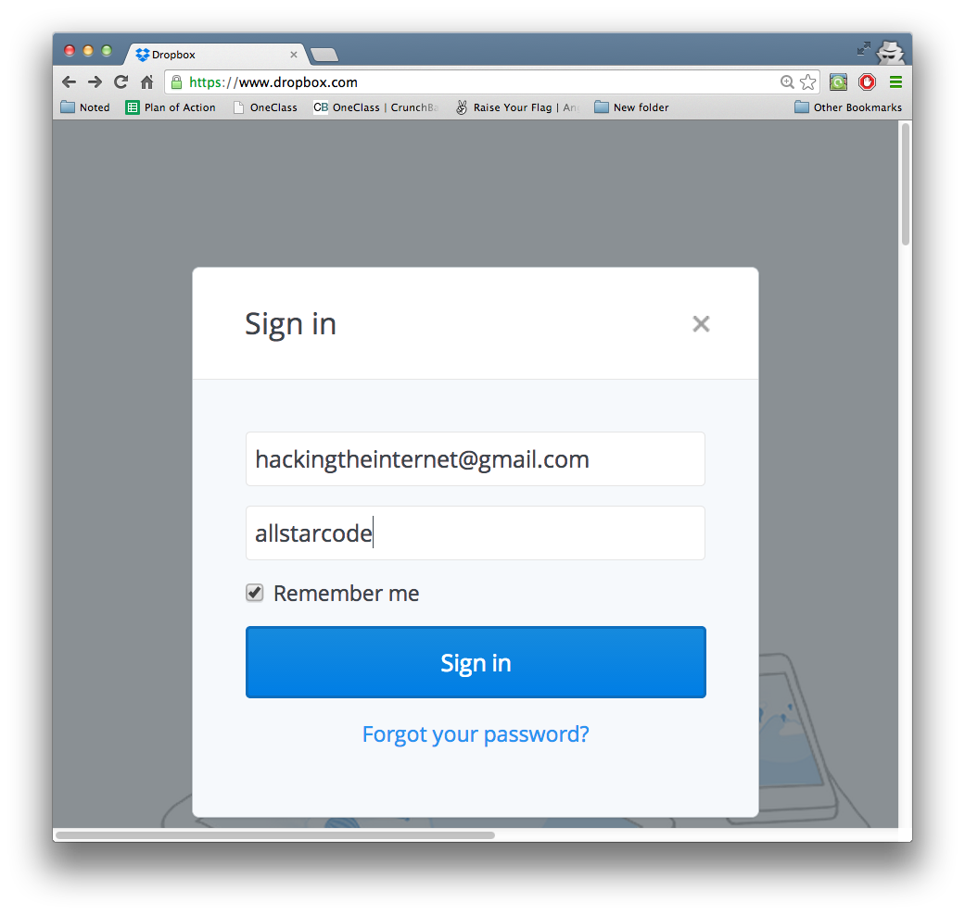
Login with the following credentials:

Slide 41

Click to open the “Public” Folder

Slide 42
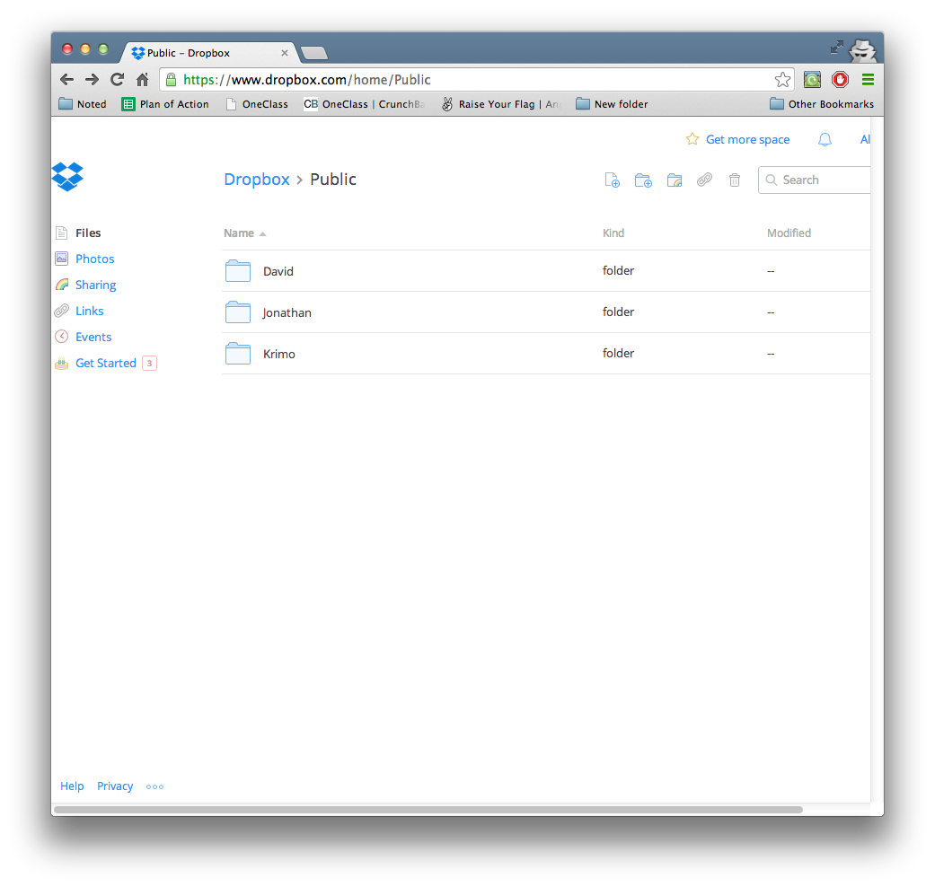
The find the folder with your name on it and click to open it

Slide 43
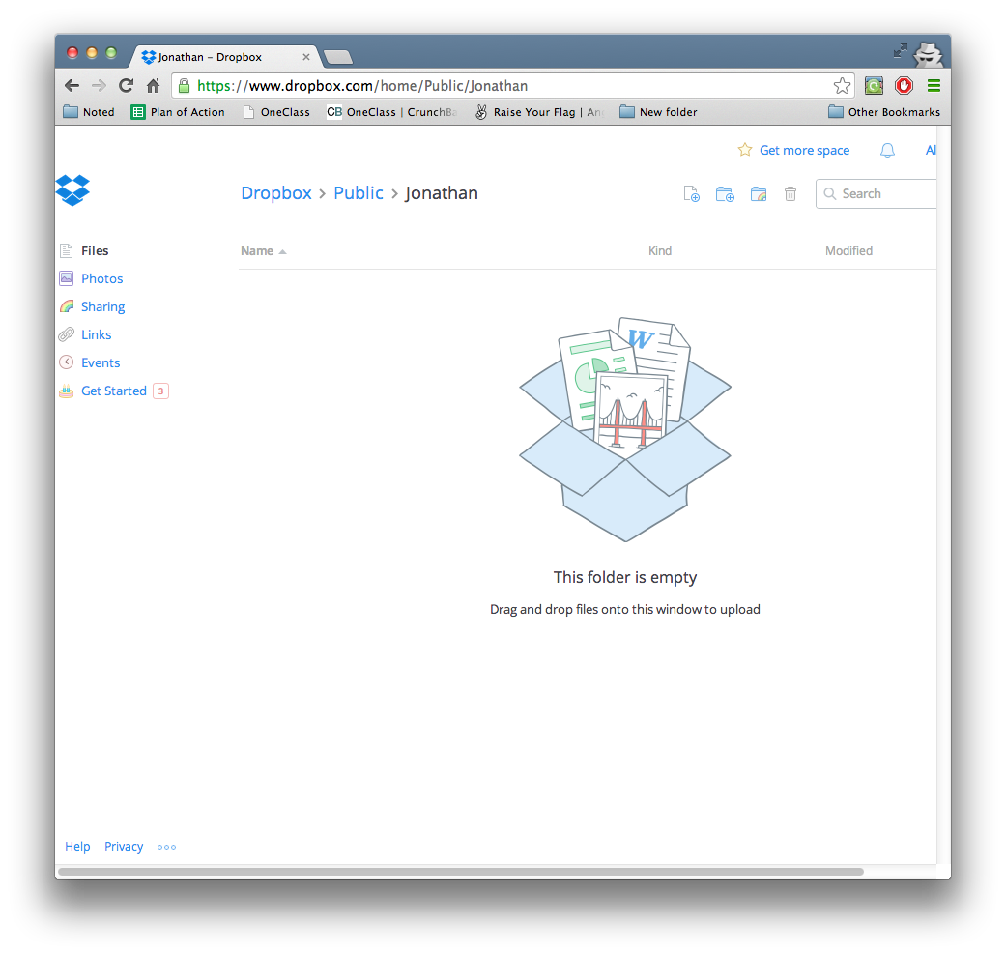
Now that you have this open

Slide 44
Drag and drop the two saved files from before into your folder

Slide 45
Drag the two saved files from before into your folder

Slide 46
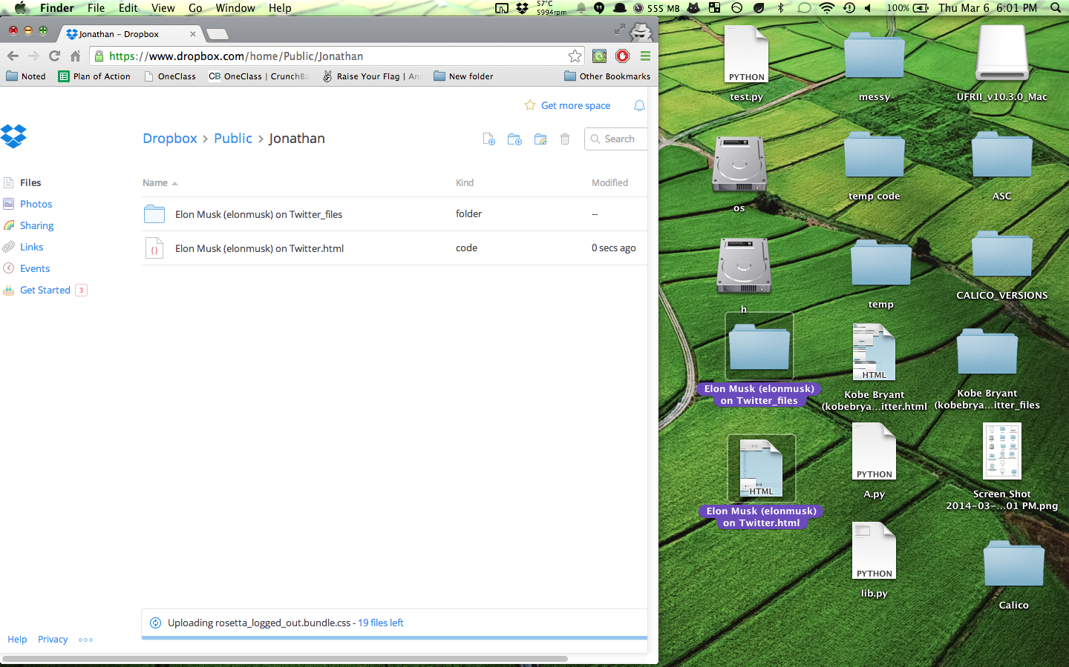
Now let go and drop the files in your folder

Slide 47
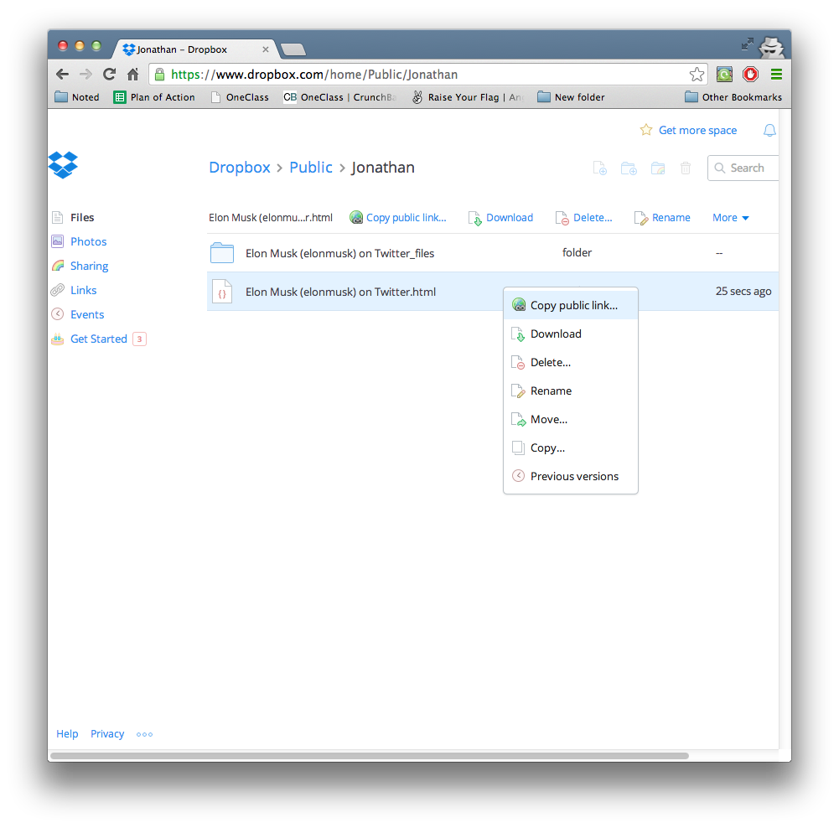
Now right click the white file that doesn’t look like a folder

Slide 48
Click Copy public link

Slide 49
Click Copy public link

Slide 50
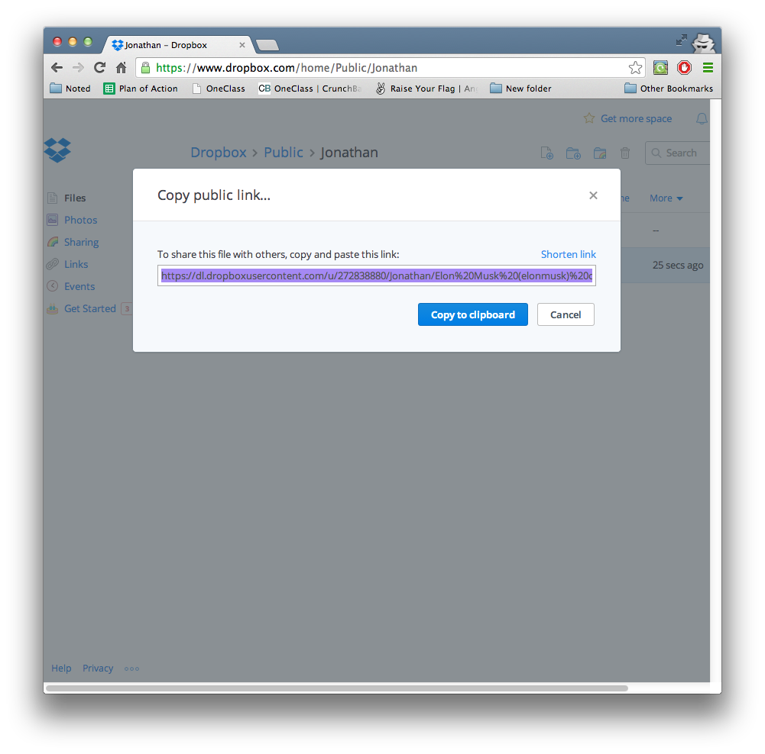
Click the “Copy to clipboard” button

Slide 51
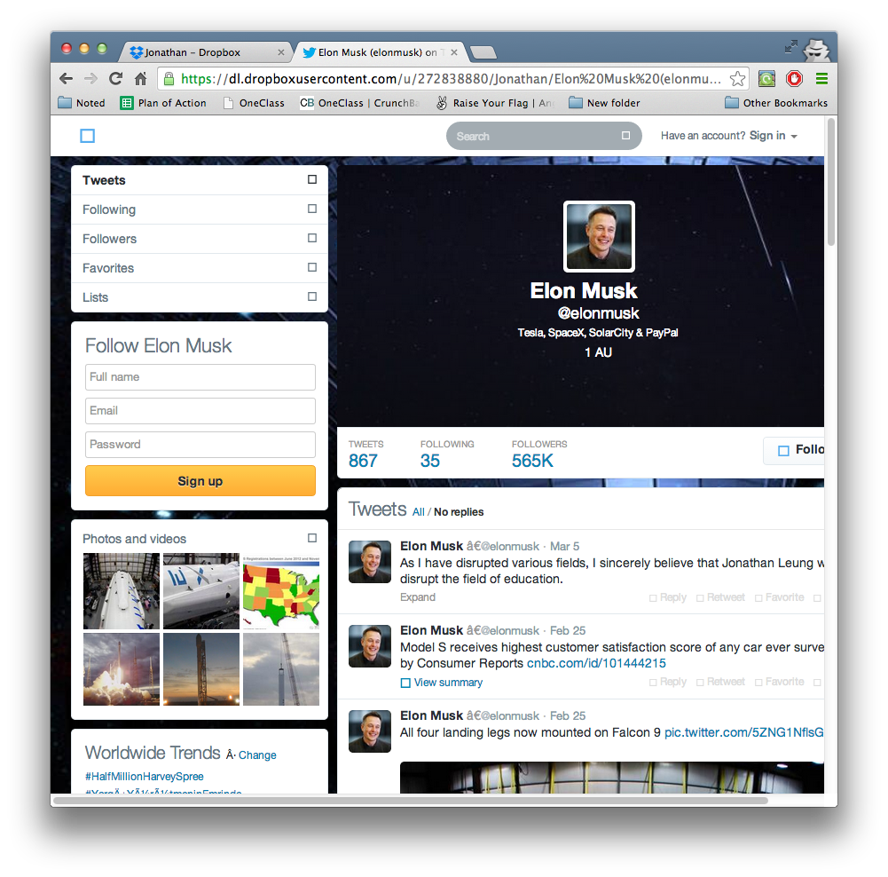

And Viola!
It.

Slide 52
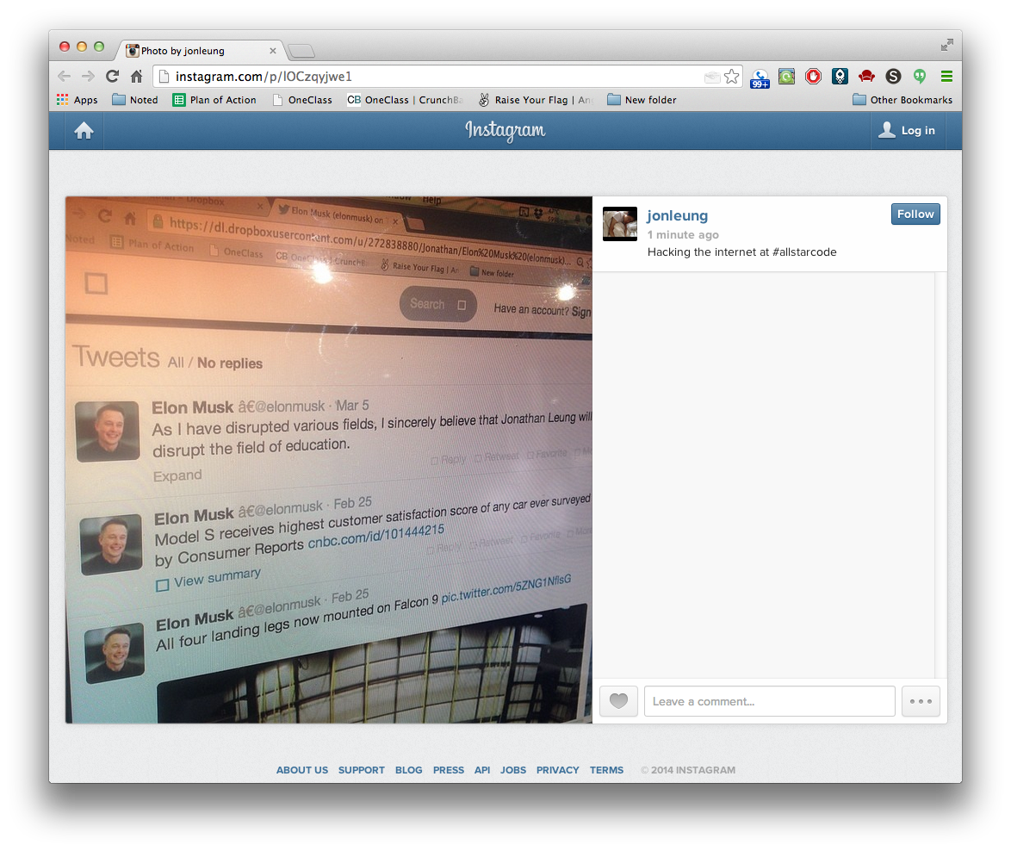

Slide 53


Give It A Try
After finishing Twitter & The NYT, experiment with other websites!
It.

Slide 54


Slide 55
Give It A Try
After finishing Twitter & The NYT, experiment with other websites!
It.

